Slide 1
Economics & Management
Lecture 12
Dua Agha
Lecturer
Dept. of Software Engineering

Slide 2
Decisions under Risk and Uncertainty

Slide 3
Risk & Uncertainty
Risk:
Risk involves situations where the probabilities of different outcomes are known. For example, when launching a new software product, there might be a 30% chance of high market acceptance, 50% chance of moderate acceptance, and 20% chance of low acceptance.
Uncertainty:
Uncertainty occurs when the probabilities of outcomes are unknown. For example, entering a completely new market with no historical data to rely on introduces uncertainty.

Slide 4
Managing Risk and Uncertainty in Software Projects
Risk Identification: Identifying potential risks that could affect the project. This includes technical risks, financial risks, market risks, etc.
Risk Assessment: Evaluating the likelihood and impact of each risk. Tools like risk matrices and FMEA (Failure Mode and Effects Analysis) can be used.
Risk Mitigation: Developing strategies to reduce the impact of risks. This might involve creating contingency plans, diversifying resources, or investing in insurance.
Uncertainty Reduction: Gathering more information to reduce uncertainty. This can involve market research, prototype testing, and iterative development practices.

Slide 5
Examples
Software Development:
When deciding on adopting a new technology, there’s a risk associated with the learning curve and potential bugs. Managers use expected value to weigh the benefits against the potential delays.
Market Launch:
When releasing a new software product, uncertainty in customer acceptance can be reduced by beta testing and gathering user feedback before full-scale launch.

Slide 6
Decision-Making Models
Several models and techniques can help in making decisions under risk and uncertainty:
Expected Value (EV)
Decision Trees
Sensitivity Analysis

Slide 7
Decision-Making Models
Expected Value (EV): This is the sum of all possible values each multiplied by their probability of occurrence. It's a common method to evaluate risky decisions.
Decision Trees: A visual representation of decisions and their possible consequences, including chance event outcomes, resource costs, and utility. Decision trees help to map out different paths and calculate the expected value for each.
Sensitivity Analysis: This technique examines how the variation in the output of a model can be apportioned to different variations in the inputs. It's useful to see how changes in key variables affect the outcome.

Slide 8

Expected Value (EV)
EV is a statistical measure used to determine the average outcome when the same experiment is repeated multiple times. It provides a way to quantify the potential outcomes of a decision by considering both the probabilities and the values of those outcomes.
It's a common method to evaluate risky decisions.

Slide 9
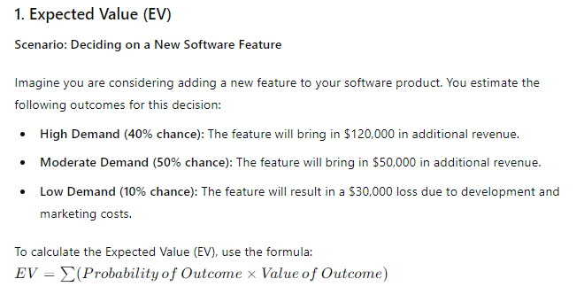
Example

Slide 10
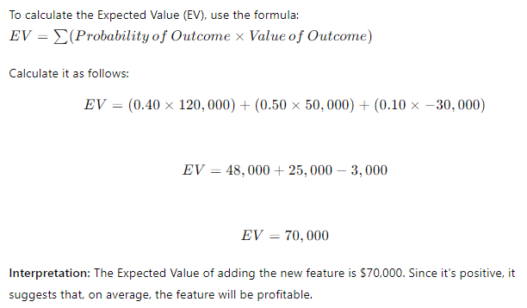

Slide 11
Decision Trees
A decision tree is a graphical representation of possible solutions to a decision based on different conditions.
It breaks down decisions into a tree-like model of choices and their possible consequences, including chance event outcomes, costs, and utilities.
Components:
Decision Nodes: Represented by squares, indicate a decision point.
Chance Nodes: Represented by circles, indicate a point where a random event occurs.
Branches: Represent the different choices or events.

Slide 12
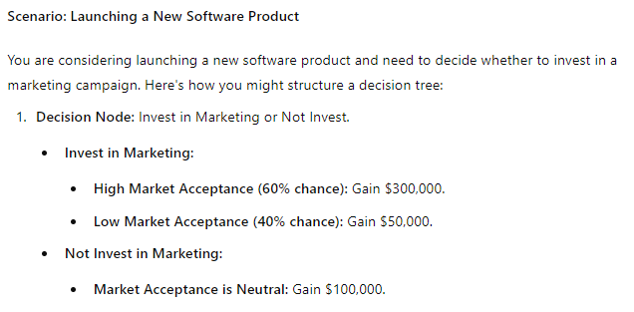
Example

Slide 13
Invest in Marketing
Invest
Not Invest
High Market Acceptance (60%)
Low Market Acceptance (40%)
Gain $300,000
Gain $50,000
Gain $100,000

Slide 14
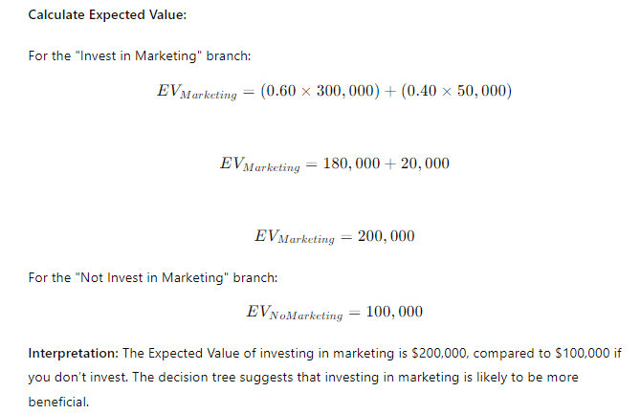

Slide 15
Sensitivity Analysis
Sensitivity analysis is used to predict the outcome of a decision given a certain set of variables by systematically varying key assumptions to assess the impact on the decision outcome.
It helps identify which variables have the most influence on the result.
Steps:
Identify the key variables that impact the decision.
Vary each variable within a reasonable range.
Observe how changes in each variable affect the decision outcome.

Slide 16
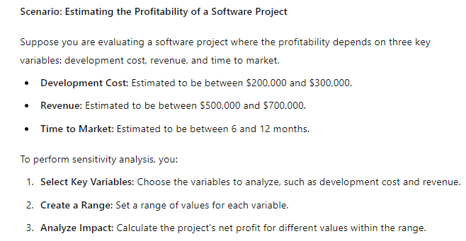
Example

Slide 17
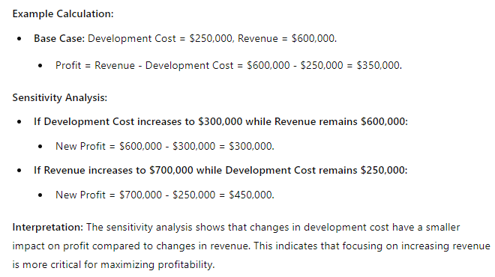

Slide 18
Summary
Expected Value: Quantifies the average outcome based on probabilities.
Decision Trees: Visualize decisions and their possible consequences.
Sensitivity Analysis: Identifies which variables most impact the outcome.

Slide 19
1. Expected Value (EV)
Question 1: You are considering launching a new feature for a software application. You estimate the following probabilities and outcomes:
High Adoption (50% chance): Gain $200,000
Moderate Adoption (30% chance): Gain $80,000
Low Adoption (20% chance): Loss of $40,000
Calculate the Expected Value of launching the new feature.

Slide 20
2. Decision Trees
Question 1: You need to decide whether to develop a new software tool. The decision tree is as follows:
Decision Node: Develop or Not Develop.
Develop:
Chance Node:
Success (70% chance): Gain $150,000
Failure (30% chance): Loss of $30,000
Not Develop:
Outcome: No change, Gain $0
Draw the decision tree and calculate the Expected Value of developing the software tool.

Slide 21
3. Sensitivity Analysis
Question 1: You are evaluating a software project with the following variables:
Development Cost: Estimated between $100,000 and $200,000
Revenue: Estimated between $300,000 and $400,000
Perform a sensitivity analysis to determine how changes in development cost and revenue affect the project's net profit. Assume the base case is a development cost of $150,000 and revenue of $350,000. Calculate the net profit for the following scenarios:
Development Cost increases to $200,000 with Revenue at $350,000
Revenue increases to $400,000 with Development Cost at $150,000

